Slide 1
Lead Scoring

Slide 2
Roadmap
-Data Analysis
-Finding out missing Data
-Dropping missing Data
-Finding out the outlier
-Plotting Graphs

Slide 3
Preparing Data(Creating Dummy values)
Scaling
Mode Building
Feature Scaling
Predicting
Plotting the ROC curve
Conclusion

Slide 4
Data analysis and cleaning
We imported the libries and made a Data Frame with the name of df1
Checked missing data on various values
Dropped all the columns which did not have strong correlation ship with the Target.
Checking Outliers and treating them
Performing Univariant Analysis between Variables
Also created heatmaps.

Slide 5

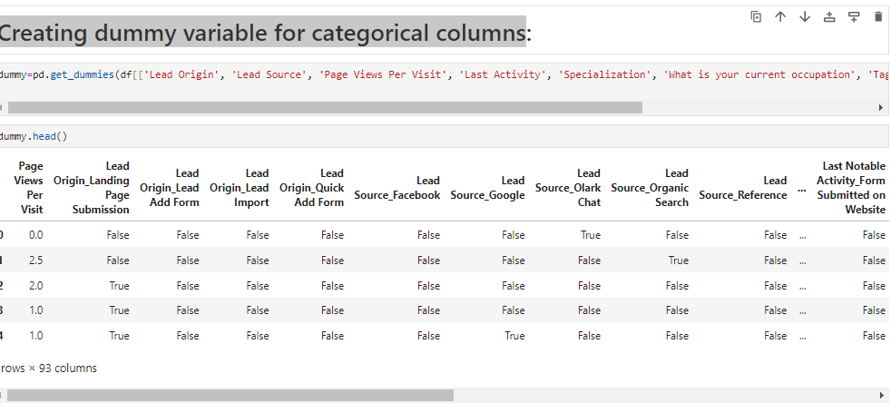
Creating dummy variable for categorical columns

Slide 6
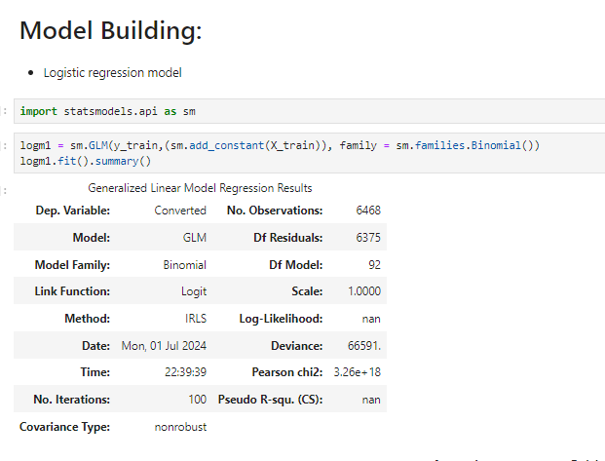

Model Building 1

Slide 7
Metrics beyond simply accuracy
Calculating the sensitivity of our logistic regression modelTP / float(TP+FN)
Calculating specificity TN / float(TN+FP)
Calculating false positive rate - predicting churn when customer does not have churned - print(FP/ float(TN+FP))
Calculating positive predictive value - print (TP / float(TP+FP))
Negative predictive value - print (TN / float(TN+ FN))

Slide 8
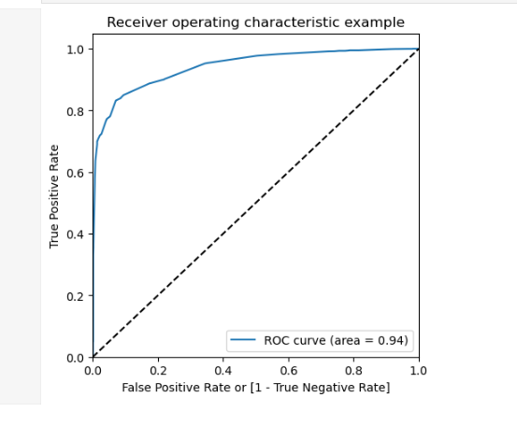
Plotting the ROC Curve:

Slide 9
Conclusion:
Training Dataset:
Accuracy: 88.57%
Sensitivity: 76.84%
Specificity: 95.80%
Test Dataset:
Accuracy: 84.61%
Sensitivity: 89.59%
Specificity: 81.34%

